Slide 1

Social Buzz

Slide 2

Today’s Agenda
Project recap
Problem
The Analytics team
Process
Insights
Summary

Slide 3

Social buzz is a fast growing technology unicorn that need to adapt quickly to it’s global scale.
Accenture has begun a 3 month POC focusing on these tasks:
An audit of social buzz’s big data practice
Recommendations for a social IPO.
Analysis to find social buzz’s top 5 most popular categories of content.
Project Recap

Slide 4
Over 100000 posts per day.
36,500,000 pieces of content per year!.
But how to capitalize on it when there is so much of incoming data day to day?
Analysis to find Social Buzz’s top 5 most popular categories of content.
Problem
Statement

Slide 5



Andrew Fleming
Chief technical Architect
The Analytics team
Marcus Rompton
Senior Principle
Murali Krishna
Data Analyst

Slide 6
PROCESS
DATA UNDERSTANDING
DATA CLEANING
DATA MODELING
DATA ANALYSIS
UNCOVER INSIGHTS

Slide 7
Insights
16
1897
JANUARY
Unique Categories
Reactions to “Animals” posts
Month with Most Posts

Slide 8
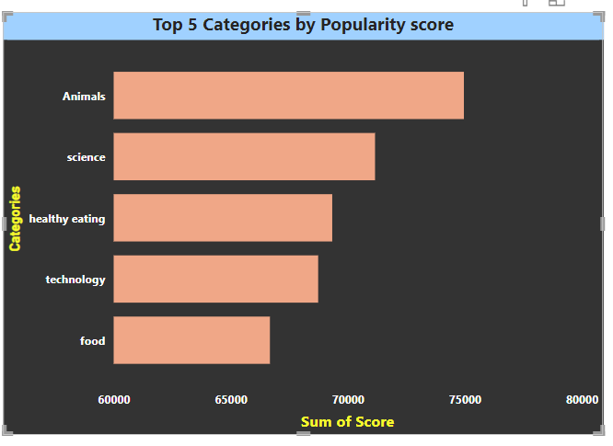

Slide 9
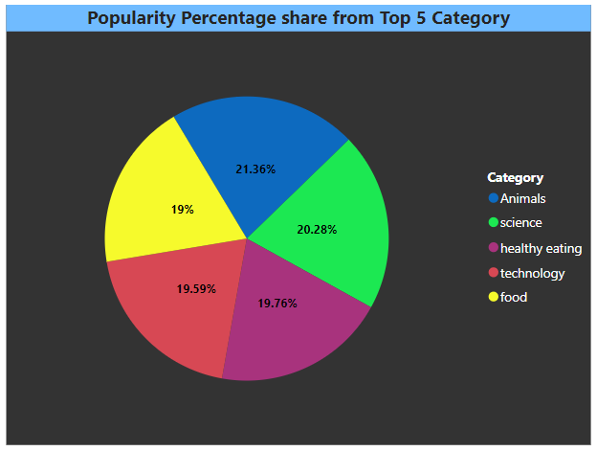

Slide 10

ANALYSIS
Animals and science are the two most popular categories of content, showing that people enjoy “real-life” and “factual” content the most.
Summary
INSIGHT
Food is a common theme with in the top 5 categories with “healthy eating” ranking the highest. This may give an indication to the audience within your user base. You could use this insight to create a campaign and work with healthy eating brands to boost user engagement.

Slide 11

THANK Y🫡U
Thank you!
ANY QUESTIONS?

